Slide 1
CS 7172 Parallel and Distributed Computation Publish and Subscribe
Kun Suo
Computer Science, Kennesaw State University
https://kevinsuo.github.io/

Slide 2
Outline
RPC problems and what is pub/sub model
P2P model vs. pub/sub model
An example of pub/sub model: Kafka
Design issues in pub/sub model
Observer Model vs. Publish/Subscribe Model

Slide 3
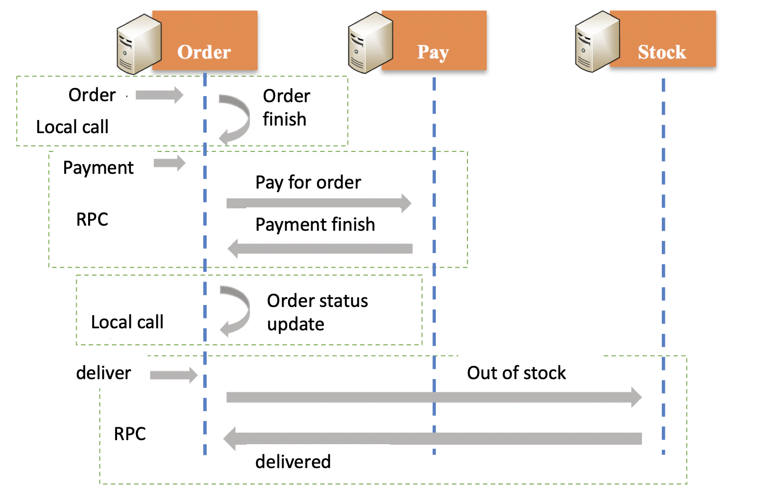
RPC and its Problems
The caller uses the parameter passing method to call a function on the local machine to execute the function on the remote machine and receives the return results

Slide 4
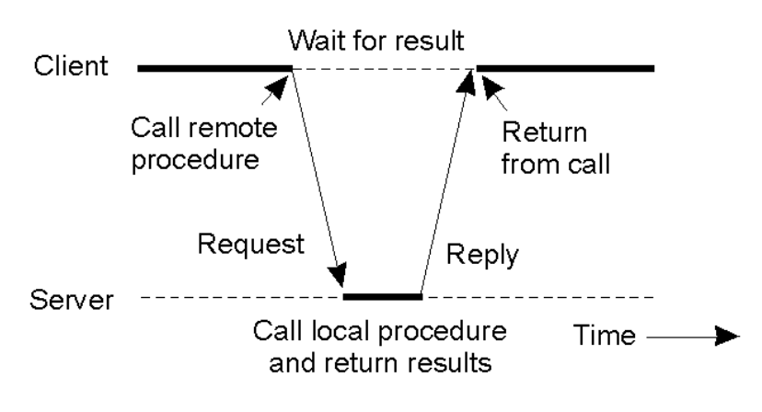
RPC and its Problems
Usually, RPCs are blocking
Thus, also useful for synchronization

Slide 5
RPC and its Problems
Most of RPC works in blocking call, which is only efficient for small number of processes
It requires to maintain the function APIs and <function, ID> tables. When one function changes, all processes communicate with it will be influenced
The synchronization in RPC has significant overhead as the scale of distributed system grows and system becomes more complex

Slide 6
What is publish & subscription?
Example: paper publication
Paper publication
subscribe
Conference or organization
Paper website
Professor and students
Push notification

Slide 7
What is Publish/Subscribe Messaging Model?
Example: twitter news feed
Publish news
Subscribe or follow
Famous people
Twitter
User
Push notification

Slide 8
What is Publish/Subscribe Messaging Model?
A general case
The producer is responsible for generating data and placing it in the message center
Consumers subscribe to the messages they are interested in
Publish
Subscribe
Producer
message center
Consumer
Push notification
When the publisher pushes the data to the message center, the message center pushes the relevant data to the corresponding subscribers according to the consumer subscription

Slide 9

How publish & Subscribe works?
Two models in distributed asynchronous message system:
P2P: Point to Point
Publish/Subscribe

Slide 10
What is Point to Point model?
Every message can only be consumed by one consumer
Producer
Consumer
Producer
message center
Consumer
Producer
Consumer

Slide 11
Point to Point model
Point-To-Point model follows these concepts:
P2P Model uses “Queue” as Destination
In P2P Model, a Sender or Producer creates and sends messages to a Queue.
In P2P Model, a Receiver or Consumer receives and reads messages from a Queue.
In P2P Model, a Message is delivered to one and only one Consumer.
Any message should be delivered to one and only one Receiver.
There is no timing dependency between Sender and Receiver. That means the Receiver can consume the messages whether it is alive or not when the Sender sent that message.
In this model, Destination stores messages till its consumed by Receiver.
Receiver sends acknowledgements to Sender once it receives messages.

Slide 12
Publish/Subscribe Messaging Model
Every message can only be consumed by different consumers
Producer
Consumer
Producer
message center
Consumer
Producer
Consumer

Slide 13
Publish/Subscribe Messaging Model
Publish/Subscribe model follows these concepts:
Pub/Sub model uses Topic as Destination.
Publisher creates and publishes messages to Topics.
Subscriber subscribes to interested Topics and consumes all messages.
Pub/Sub Messaging model has timing dependency. That means Subscriber can consume messages which are published to the Topic only after it subscribes to that Topic. Any messages posted before its subscription or any messages posted when it is inactive, cannot be delivered to that Consumer.
Unlike P2P Model, in this model Destination does not store messages.

Slide 14
Differences between P2P and Pub/Sub Messaging Model
Point-To-Point Messaging Model | Publish/Subscribe Messaging Model
Each message is delivered to one and only one Receiver | Each message is delivered to multiple Consumers.
P2P Model has no timing dependency. | Pub/Sub model has some timing dependency.
Receiver sends acknowledgements to Sender once it receives messages. | Acknowledgement is not required.
Destination stores messages till its consumed by Receiver | Destination does not store messages

Slide 15
Example: Kafka
Apache Kafka is an open-source stream-processing software platform developed by LinkedIn
The project aims to provide a unified, high-throughput, low-latency platform for handling real-time data feeds
https://kafka.apache.org/

Slide 16
Kafka architecture
The architecture of Kafka includes 3 parts:
Producers are responsible for publishing messages to the message center;
Consumers subscribe to messages of interest to the message center, and then perform data processing after obtaining data;
Message center (Broker) is responsible for storing messages published by producers and managing consumer subscription information and pushing messages to consumers based on consumer subscription information.

Slide 17
Kafka architecture
Broker is to store the message data
Consumer is to cosume the message data

Slide 18
Kafka architecture
Both Consumer and Broker will register to ZooKeeper when they start, and ZooKeeper is use to manage and coordinate them uniformly

Slide 19
Topics in Kafka
Topic refers to message types or data types
Each producer can publish different topics of messages
Each consumer can subscribe different topics of messages

Slide 20
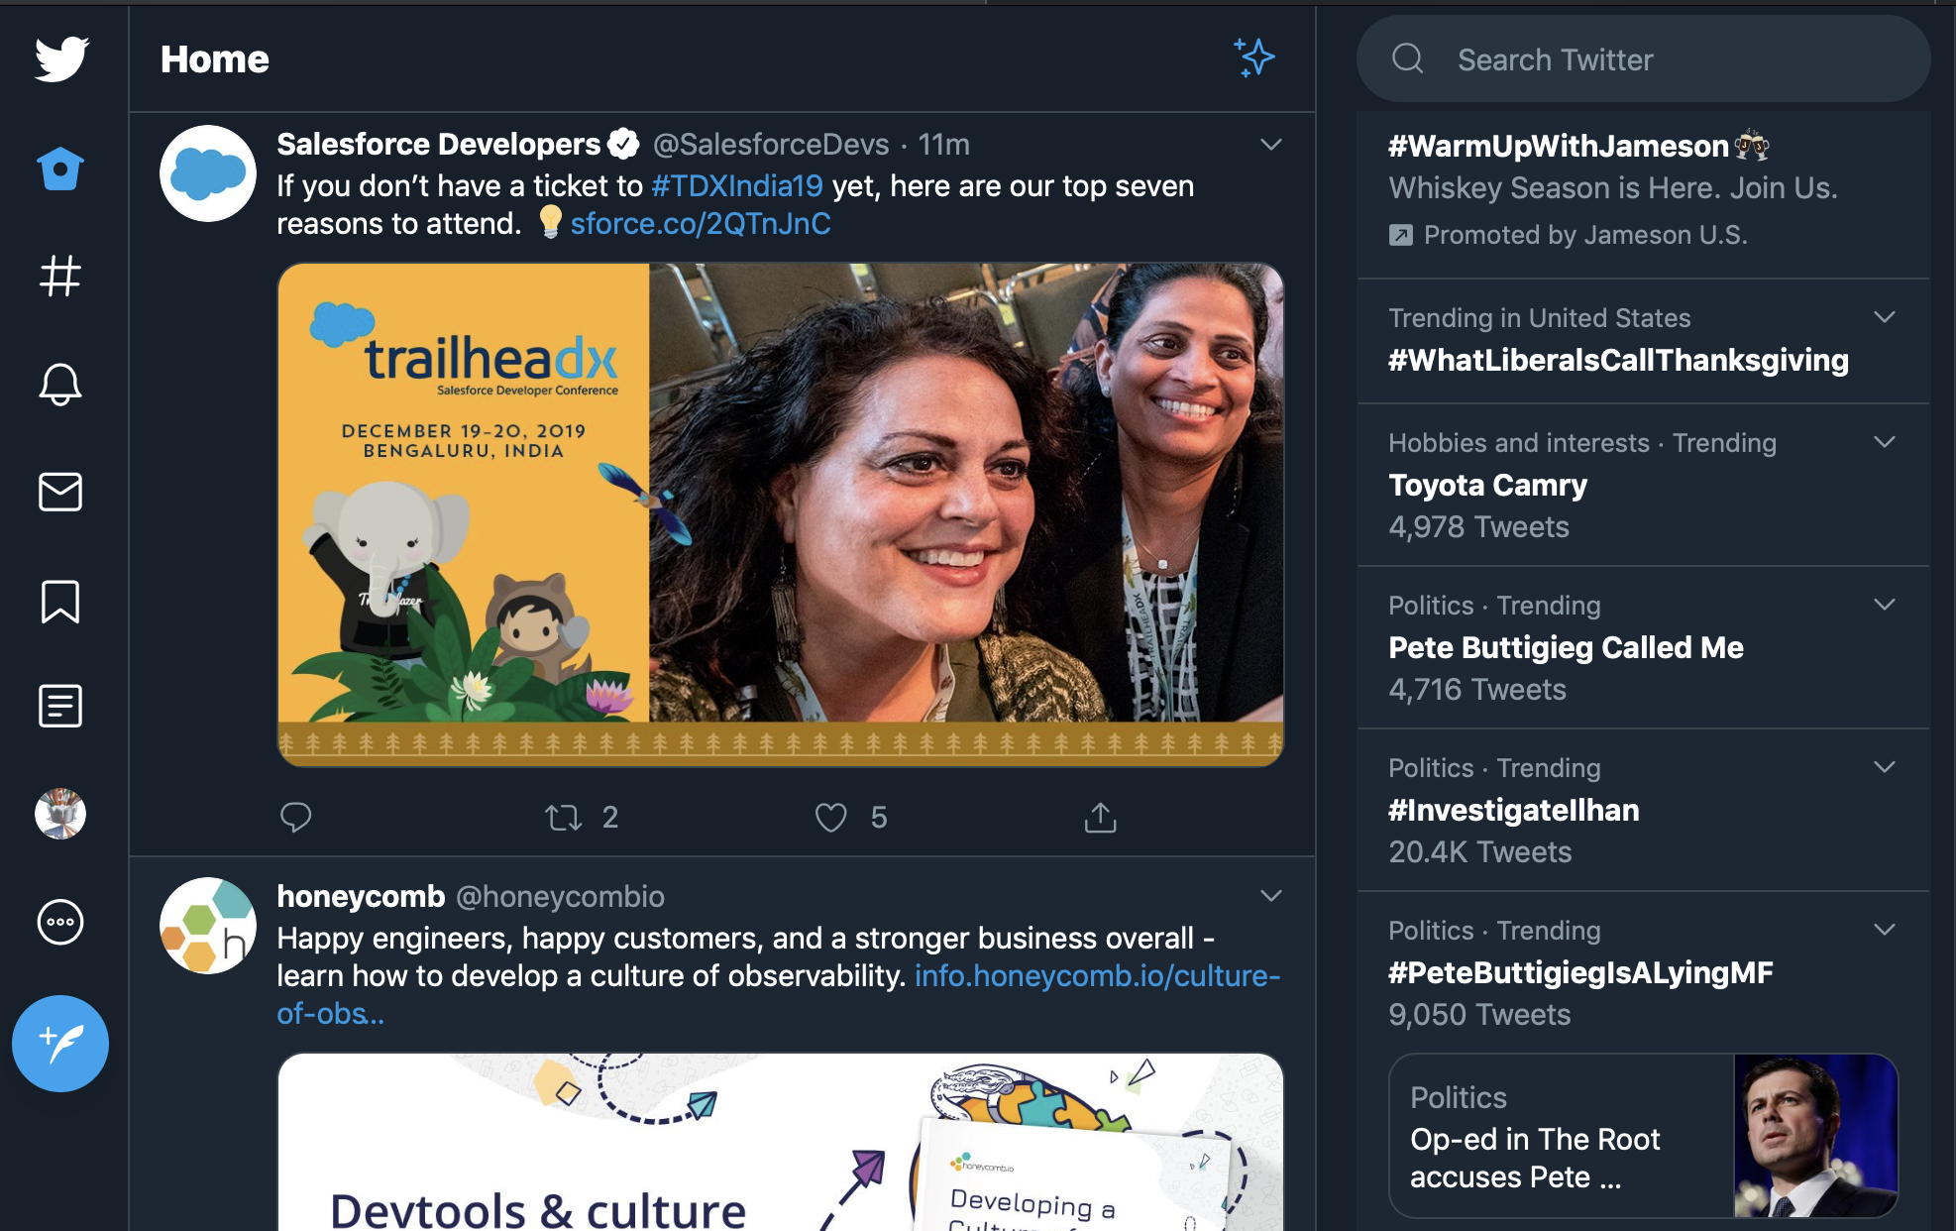
Topics Example

Slide 21
Partitions in Kafka
Each topics can be divided into different partitions
Different partitions are existed at different brokers
One partition of one topic is located at one broker (e.g., Topic-0, partition-0)

Slide 22
Partitions in Kafka
The benefits of partitions:
Load balance: avoid too high load on a single broker.
For instance, topic 0 is divided into partition-0, partition-1, partition-2, and is located at broker-0, broker-1, broker-2. Thus, topic 0 is at three machines.
Message backup: achieve high reliability.
For instance, topic 1 contains two partition-0s, which are stored at broker 0 and broker 1.

Slide 23
Consumer group in Kafka
Consumer group is a set of consumers
Every message of one topic can only be consumed by a single consumer with one consumer group

Slide 24
Consumer group in Kafka
The benefits of consumer group:
Because one consumer is limited to consume messages, consumer group can avoid storage overflow of broker when there are too many messages

Slide 25

Revisit Load Imbalance in OS
ready queue
pick_next_task()
processor
Every a while, a kernel thread checks
load imbalance and move threads
Kick
…
…
Made by OS
ready queue
pick_next_task()
processor
ready queue
pick_next_task()
processor
…
steal
…
Whenever a queue becomes empty,
steal a thread from non-empty queues
ready queue
pick_next_task()
processor
Made by local queue. Both are widely used

Slide 26
Load Imbalance in Publish/Subscribe Models
Message center pushes message to consumers:
Controlled by the message center
Risky for the consumer side because too many messages could overwhelm the consumer side
Producer
Push
Consumer
Producer
message center
Consumer
Producer
Consumer

Slide 27
Load Imbalance in Publish/Subscribe Models
The message is pulled by the consumer actively
Controlled by the consumer
Risky for the message center side because too many messages could use up the storage resource of message center and make some messages lost
Pull
Producer
Consumer
Producer
message center
Consumer
Producer
Consumer

Slide 28
Publish/Subscribe Models in Amazon
Order
Pay
logistics

Slide 29
Publish/Subscribe Models in Amazon
Payment system
subscribe
Order system
message center
publish
subscribe
logistics
system

Slide 30
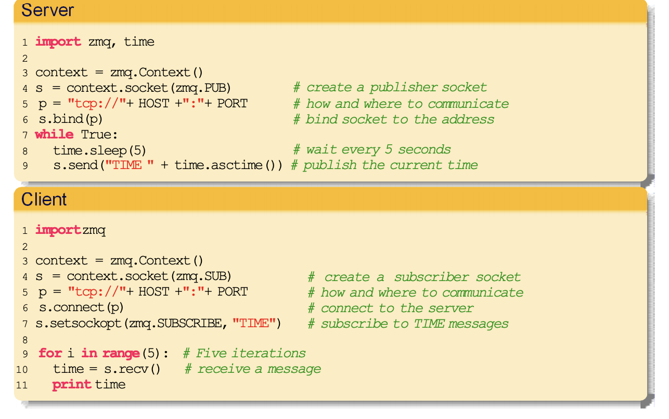
Publish-subscribe in ZeroMQ

Slide 31
Advantages of Publish/Subscribe Models
The system is decoupled and easy to maintain.
Producers/publishers are only responsible for the release of messages
Producers/publishers do not need to know the number of subscribers/consumers
Producers/publishers do not need to know what subscribers/consumers use messages for
Subscribers/consumers do not need to know when Producers/publishers post messages.

Slide 32
Decoupled in Different Aspects
Space decoupling. Interacting parties don’t need to know about each other
Publishers/subscribers don’t need to hold references to each other
Time decoupling. Need not be actively participating/running at the same time.
Subscribers can get disconnected and be notified later
Synchronization decoupling. Sender, receiver should not block
Publishers not blocked while producing events
Subscribers can get async notified via callbacks
Production/consumption do not happen in main flow of control
Increases scaling, since there is no explicit dependency

Slide 33
Advantages of Publish/Subscribe Models
2. Implement asynchronous execution to avoid high load.
Producers/publishers publish messages to the message center. When the messages exceed the storage capacity of the message center, the message center will discard the excess messages, so that the system will not cause failure due to the large number of messages.

Slide 34
Observer Pattern/model
The observer pattern/model is a software design pattern in which an object, called the subject, maintains a list of its dependents, called observers, and notifies them automatically of any state changes, usually by calling one of their methods.

Slide 35
Example of Observer Pattern/model
Observers
Observer and subject interact or communicate directly
Process B
{
if X == 4:
X++
}
Subject
Process A
X=3
Notify
Notify
Process C
{
if X == 4:
X--
}

Slide 36
Publish/Subscribe Model
Publisher and consumer interact or communicate indirectly
Introduce more latency but decouple the system
Publisher
Consumer
Publisher
message center
Consumer
Publisher
Consumer

Slide 37
Difference between Observer Model and Publish/Subscribe Model

Slide 38
Difference between Observer Model and Publish/Subscribe Model
Observer Model | Publish/Subscribe Model
The observer knows the subject, and the subject keeps a record of the observer. | Publishers and subscribers are unaware of each other's existence. They only communicate through the message broker.
Components are coupled | Components are decoupled
The observer mode is mostly synchronous. For example, when an event is triggered, the subject will call the observer's method | The publish-subscribe model is mostly asynchronous (using message queues)
The observer pattern is usually implemented in a single application | The publish-subscribe model is widely used in distributed systems

Slide 39
Conclusion
RPC problems and what is pub/sub model
P2P model vs. pub/sub model
An example of pub/sub model: Kafka
Design issues in pub/sub model
Observer Model vs. Publish/Subscribe Model

